Slide 1

STEP FUNCTIONS AWS

Slide 2
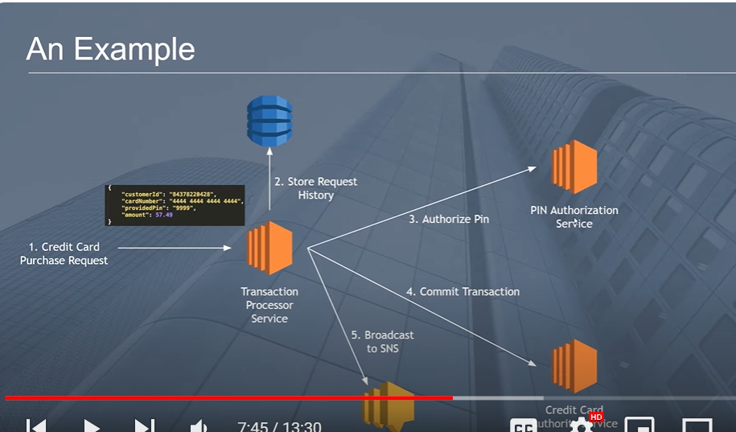
Credit card transaction example?

Slide 3
Why step functions?
Step functions help to automate the work.
Orchestrate sequence of events, to provide some retry policies as well.
And build retry policies
Have more control on the flow of work.

Slide 4
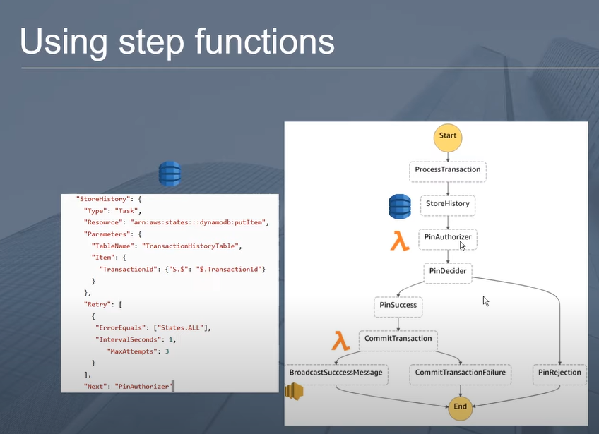
Mimicing the credit card transaction using step function

Slide 5
Step functions language
Step functions are written in Amazon States Language (ASL).
Required to create an IAM role for the Step function to trigger a Lambda or any other service.

Slide 6
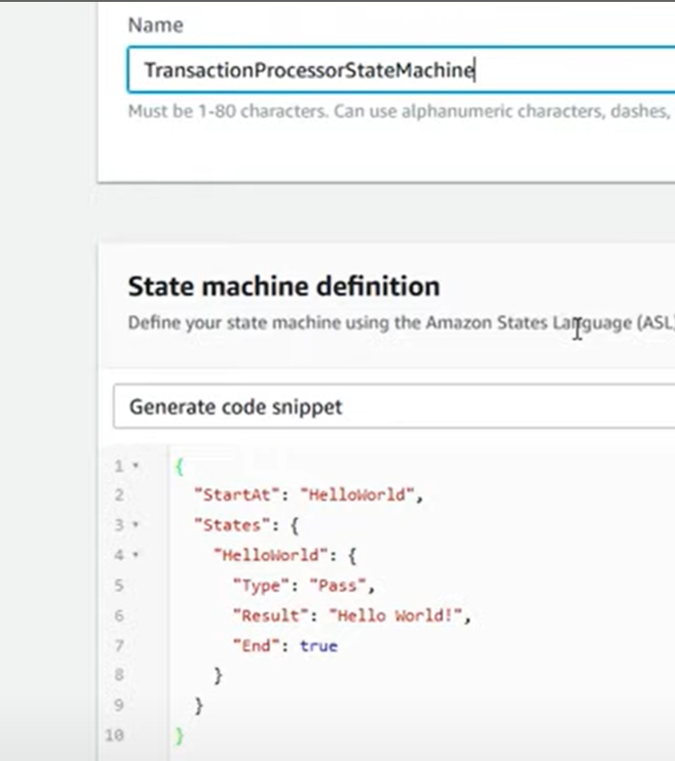

Slide 7
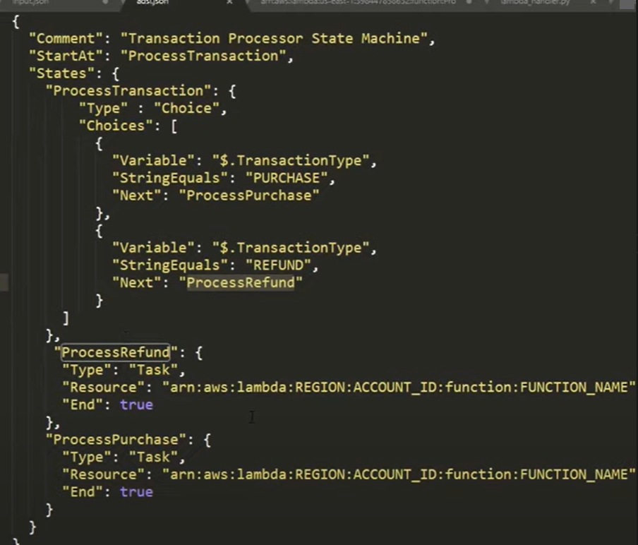

Slide 8
ECR
ECR is a place where images are hosted.
Image hosted in the ECR is being used in ECS.
ECR stores the history of all the images you have created over time.
After you have uploaded your docker image with a name, then comes ECS.

Slide 9
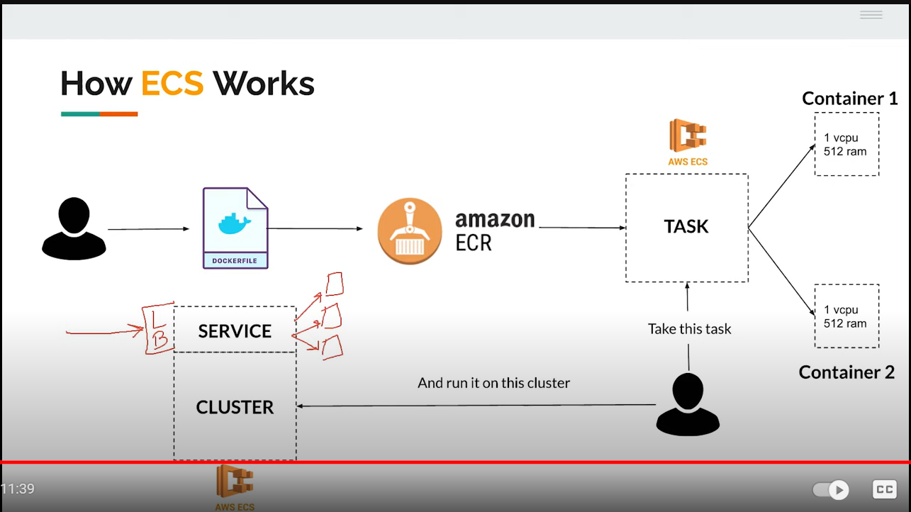

Slide 10
